Slide 1

Quantum machine learning
A seminar representation
on
Next big thing...

Slide 2

Mr. Omkar S. Raut (10303320181124510008) B. Tech Computer Engineering under the guidance of
Given by
Dr. Arvind W. Kiwelekar
Professor, Dept. Of computer engineering,
Dr. Babasaheb ambedkar technological university, Lonere, Raigad.

Slide 3
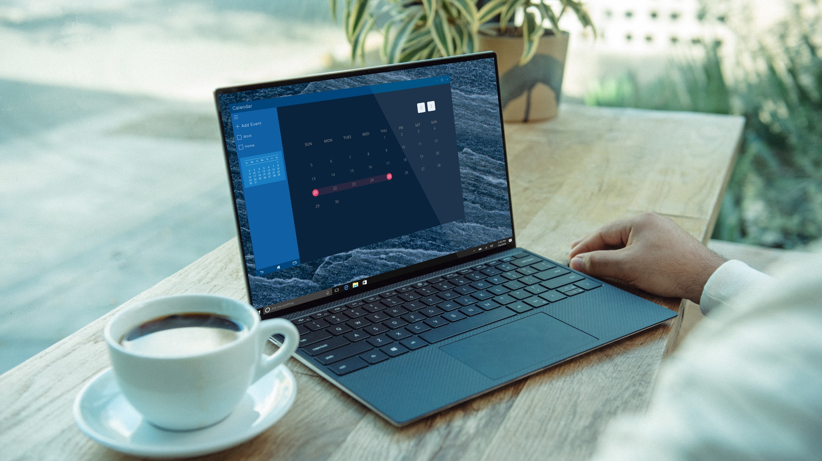
Agenda
Introduction
Quantum Computers
Machine Learning
Concepts of quantum
Quantum Algorithm
Overview of QML
Quantum SVM
Applications of QML
Advantages and disadvantages of QML
Conclusions

Slide 4
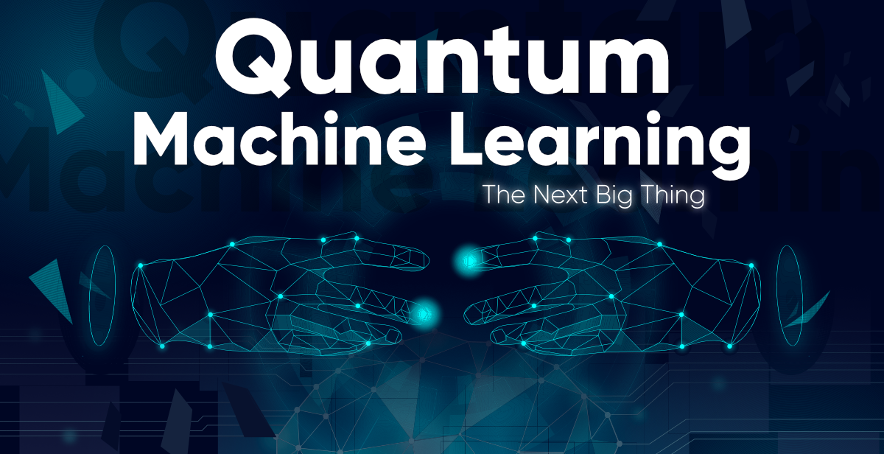

Slide 5


Introduction
QML is one of the best area for research, today.
QML is a technology which is developed by combining the principles of quantum physics and machine learning.
In simple words, QML is the execution of machine learning programs on quantum computers.
In QML, quantum algorithms are developed to solve complex problems using the efficiency of quantum computing.
There are only few people in the world, who have knowledge of quantum computing.
Google announced that they have a quantum computer in their lab which is 100 times faster than our classical computer.
According to Professor Catherine McGeoch at Amherst University, a quantum computer is thousands of times faster than a conventional computer.
As we have seen in the last slide, it is the big thing, and it will helps us to create solutions of many real time complex problems.

Slide 6

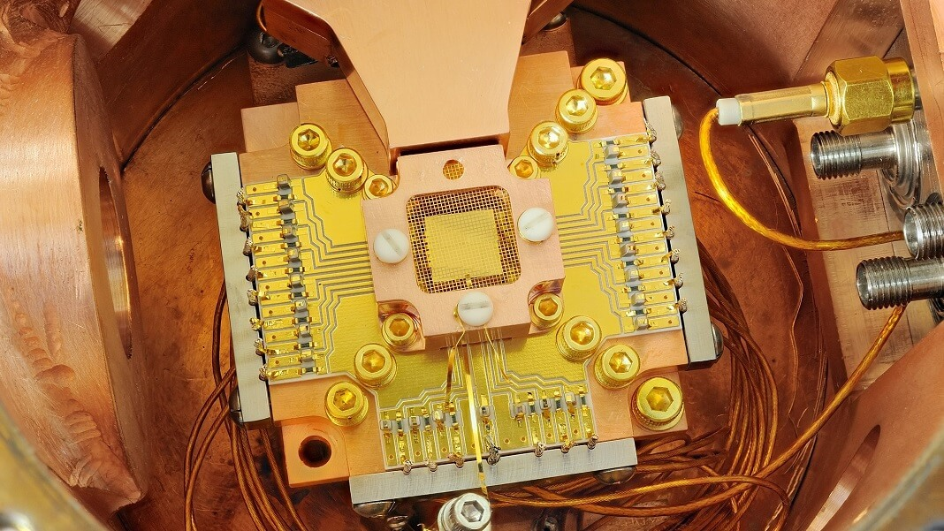
What is Quantum Computer?
Quantum computing is the use of quantum concepts such as superposition and entanglement to perform computation. Computers that perform quantum computations are known as quantum computers.
Quantum computers are too much faster than classical computers. The reason behind that is they have qubits instead of bits. Classical computers understand only binary digits (0, 1) and perform all computations in the binary format. So, for complex tasks it will take too much time.
quantum computer have qubits (quantum bits), they can store more than one value at a time. So the computation time will decrease. Hence these computers can perform a complex tasks in a small amount of time.

Slide 7

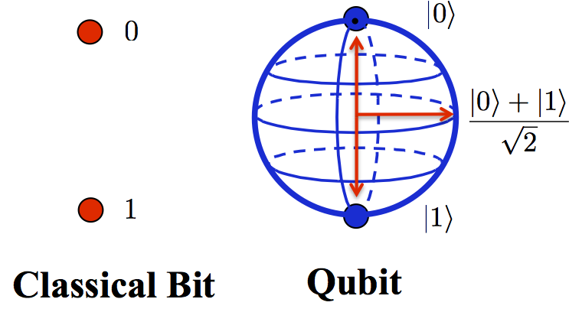
Why we need quantum computers?
We know that the data is increases day by day. We produce 2.5 exabytes of data per day. The size of data increases day by day. The classical computer is unable to process this huge amount of data and it fails to computation on this data. Even if a classical computer able to compute such a big data. It will take too much time to make computation. The reason is that it understand only the binary digits (0, 1). It convert all data in the binary form. At a time it can store only ane value. So it require huge amount of time ti make computation.
Quantum computer is thausand time faster than the classical computers. Quantum computers have qubit which is also called as quantum bits. It can store more than one value at a time and hence the computation power of the computers will be increased. Even if the complex task is there then also it will perform it in a small amount of time.

Slide 8

Machine Learning
Machine learning is a technology in which we will train the machines so that it will think like a human and can perform like a human.
To implement that we have to provide complex algorithms. We have to take a data process it and train a model from that provided data.
At the end, we have to test the model, whether it works fine or not. To train and test the model, we will split the data in train test in 7:3 ratio.

Slide 9
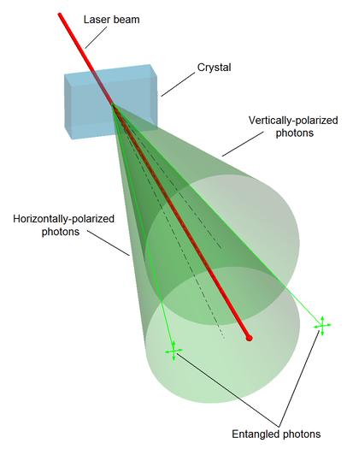
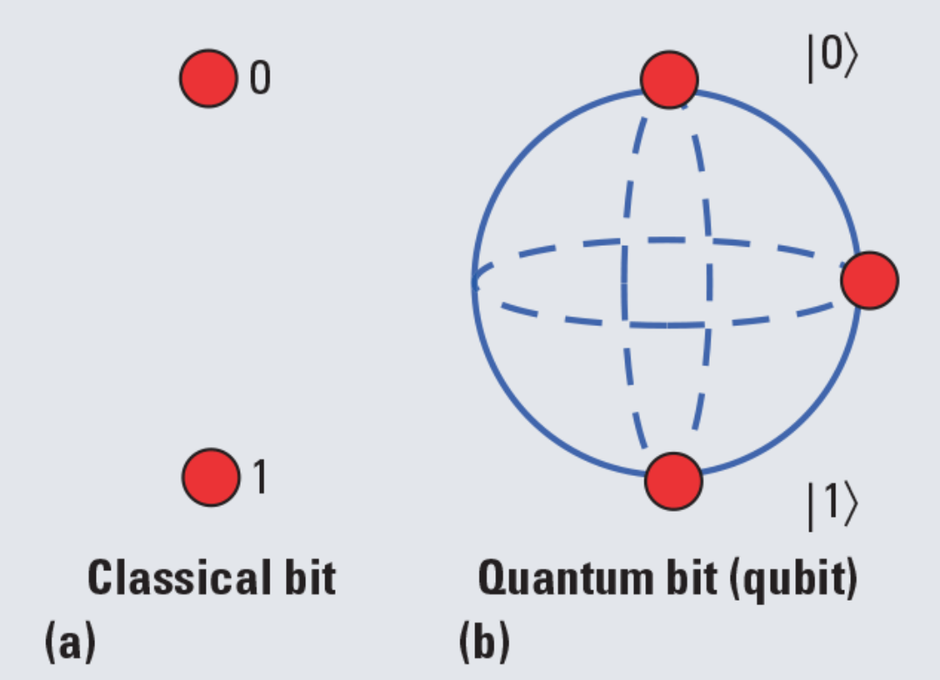
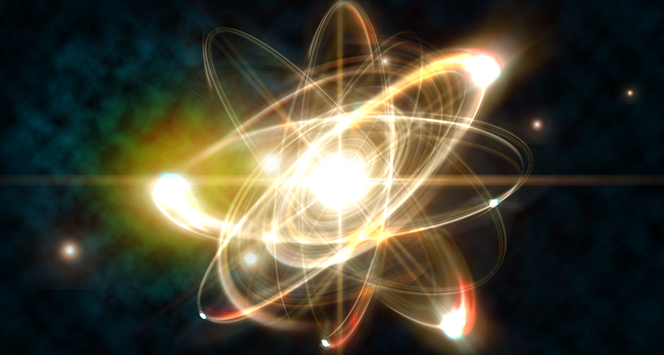
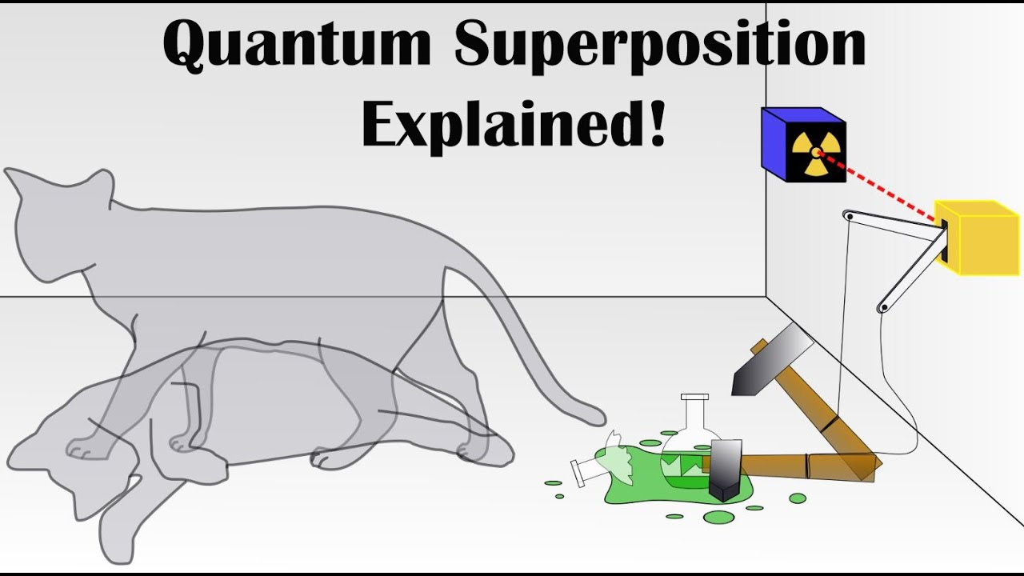
Concepts of quantum used in machine learning
Quantum
Qubits
Superposition
Entanglement

Slide 10
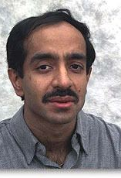
Grover's Algorithm
Lov Kumar Grover is an Indian-American computer scientist. He is the originator of the Grover database search algorithm used in quantum computing.
If I have an unstructured list of n elements, and I have to search a particular element in that list. At the worst case that is when the element is at the last of the list. Then I will require n number of iterations. So, it has O(n) complexity.
But if I use Grover's algorithm on quantum computer, it will check at multipple places at a time, So it will require less number of iterations. The complexity of it will be O(sqrt(n)).

Slide 11

An overview of QML
Quantum machine learning means execution of machine learning algorithms on quantum computers.
I found that most of the quantum machine learning algorithms are based on the application of Grover's algorithm or one of its variants. This include mostly unsupervised methods.
In addition, quantum associative memory and quantum neural networks are also based on this search. The new versions of the quantum support vector machine also uses Grover’s search. Almost half of all methods of quantum machine learning uses this algorithm.
Grover’s algorithm is also be used for estimating the mean and median of a set of numbers, and solving the collision problem.

Slide 12

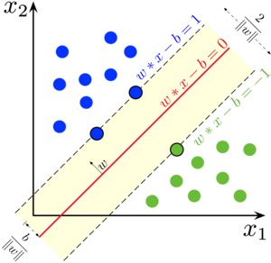
Quantum SVM
Data classification is one of the most important tool of machine learning today. It is used to identify, group and study new data. These machine learning classification tools have been used in computer vision problems, medical imaging, drug discovery, handwriting recognition, geostatics and many other fields.
SVM is similar to what happen inside the quantum computers.
We know, SVM is generally used for classification problems. If the data points are linearly seperable then it will directly classify that points and can classify a new data point among the classes. But if the data is not linearly separable, then SVM convert it in the higher dimension and then it can easily classify all the data points. If the dimension of the data is very high then the classical computer is unable to classify the data points, or it will take too much time to do this task. But if we use quantum computer to do this task, it will easily do it with the small amount of time. Hence the training time is also decreases.

Slide 13
Understanding nano-particles
The creation of new materials through molecular and atomic maps
Molecular modelling to discover new drugs and medical research
Understanding the deeper make-up of the human body
Enhanced pattern recognition and classification
Furthering space exploration
Creating complete connected security through merging with IoT and block-chain
Applications of QML

Slide 14

Advantages of QML
Quantum machine learning can speed up the training time.
Quantum machine learning can use quantum tunnelling to get the true object instead of gradient descent.
Quantum machine learning can represent more complex network topology.
We know that if the data have higher dimensions then the classical computers are unable to do such a complex computation. Quantum computers can easily perform such complex tasks with small time. It is generally happen in the support vector machine algorithms.
Every day, we produce 2.5 exabytes of data. That number is equivalent to the content on 5 million laptops. Quantum computers will make it possible to process the amount of data we’re generating in the age of big data.
Superposition is the term used to describe the quantum state where particles can exist in multiple states at the same time, and which allows quantum computers to look at many different variables at the same time.

Slide 15

Quantum computer will change the landscape of data security. Even though quantum computers would be able to crack many of today’s encryption techniques, predictions are that they would create hack-proof replacements.
In order to keep quantum computer stable, they need to be cold. I has -460 Fahrenheit.
Classical computers are better at some tasks than quantum computers (email, spreadsheets and desktop publishing to name a few). The intent of quantum computers is to be a different tool to solve different problems, not to replace classical computers.
. Quantum computers are very fragile. Any kind of vibration impacts the atoms and causes de-coherence.
Disadvantages of QML

Slide 16
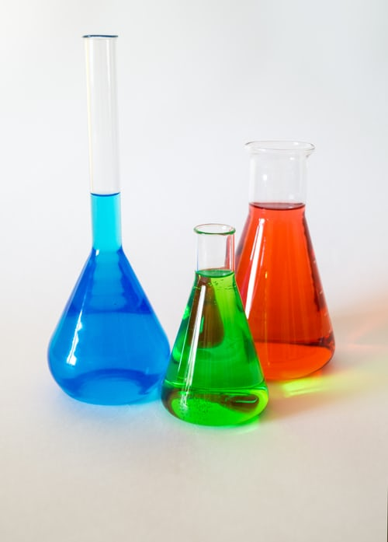
Conclusion
Today’s world is depend on data. The new data is created every day, and the size of the data is increases day by day. So, to handle and processing this huge data, the classical computer takes too much time. Some classical computers are not able to do computation this high dimensional data. Luckily, we have quantum computers which can handle this high dimensional data. It is more faster than the classical computers. Quantum computer can compute high dimensional data in very small time.
Support vector machine is similar to the what happen inside the quantum computer. Quantum machine learning have some best features like superposition. It will store more than one values at a time. So the processing time reduces and the complex tasks also complete within very small time.

Slide 17


